Slide 1
@garrybodsworth
SECURITY
IS
HARD
garry.bodsworth@gmail.com
www.bromium.com

Slide 2
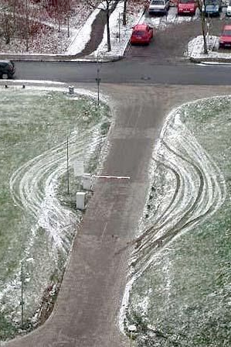
what is security?
Protect infrastructure
Protect business
MOST IMPORTANTLY Protect Customers
Process not a product
Privacy
Notes:
Process - not a product - it is in the fabric
When you buy more security - YOU ARE DOING IT WRONG
Deliberately conflating security and privacy - both are intertwined

Slide 3

security needs to be part of the process from the start
Notes:
Evernote - no security - get compromised - then they start trying to hire a security team.
As your program evolves, security must always be considered.

Slide 4
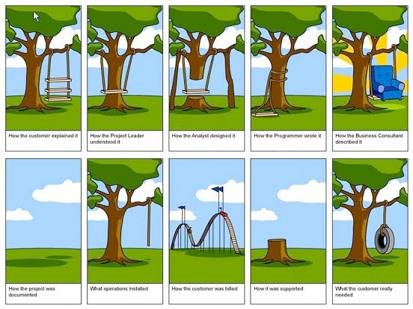
Why is there no security-driven-development?
Notes:
Most people will recognise this comic

Slide 5

Notes:
This is what a security person sees.
And this is just scratching the surface

Slide 6

have you tried to add tests to a legacy system???
this is even harder
Retroactively add “security”?
Notes:
Retroactively writing tests for a legacy system is hard
Adding security is an order of magnitude harder
Evolution is sometimes not possible and involves starting again

Slide 7
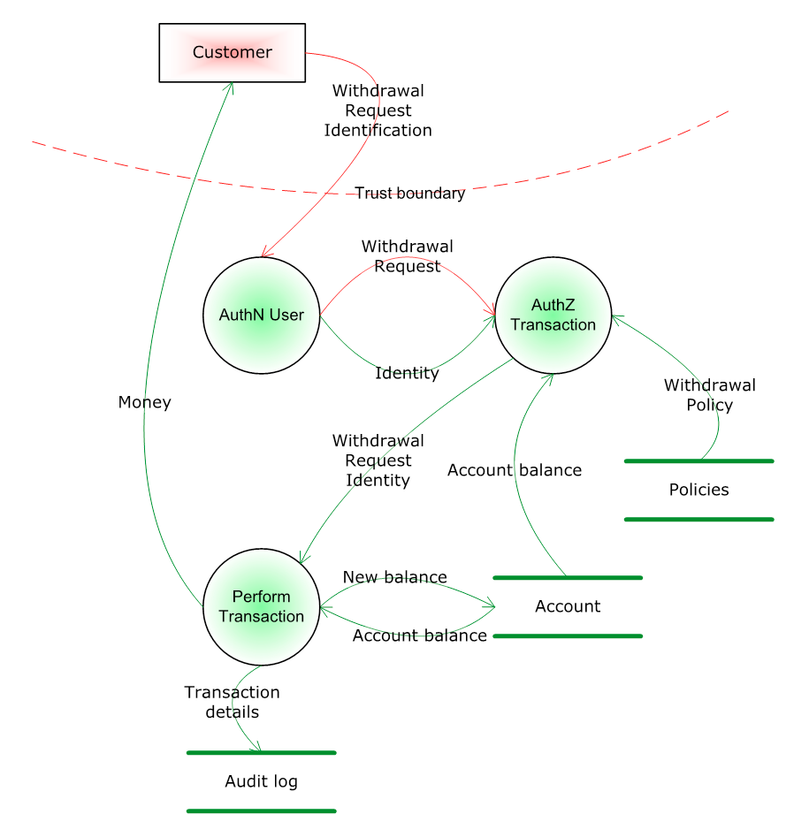
threat modelling
From http://blogs.msdn.com/b/ptorr/archive/2005/02/22/guerillathreatmodelling.aspx
Notes:
Threat modelling - as used by Microsoft
Attempts to map the data flows of sensitive information
Rarely successfully models the system
Consumers tend to be non-expert/management so it is normally dumbed-down for consumption

Slide 8
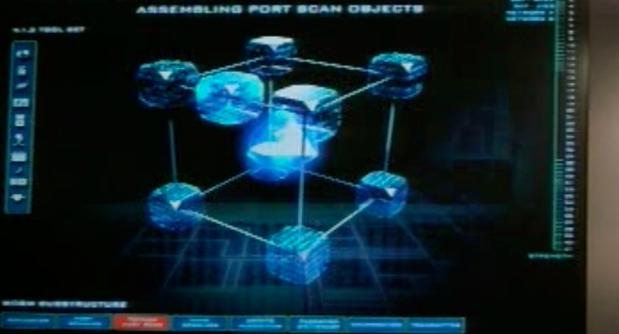
perfect code still exploitable
but… but… there are no buffer overflows
Notes:
Perfect code is still exploitable
Imagine mathematically proved perfect code getting released. Gets owned by a script kiddie in a few hours.
Need to consider more than simple buffer overflows when designing.

Slide 9
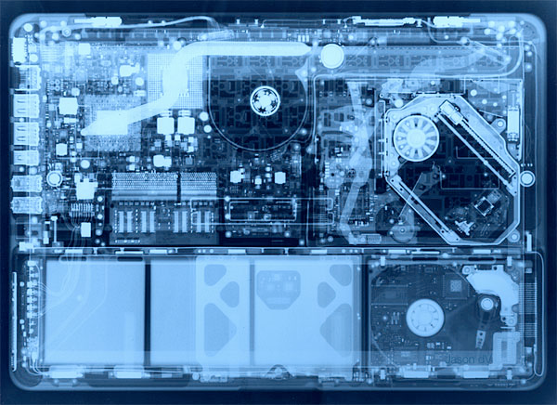
exposing the inner workings of your site
Notes:
Unwittingly exposing internal implementation and data relationships - I get quite a lot of push back on this - especially from REST purists.
Your API should abstract into higher level semantics, because if it looks like the building blocks you can’t protect how those interact easily.

Slide 10
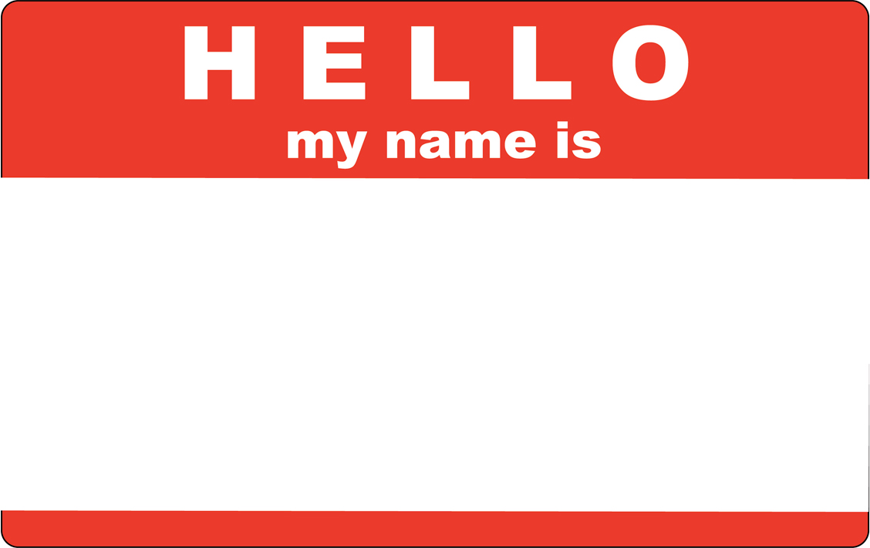
Why Not?
79dd0633-5ad7-4081-a0e9-9f6ee083e6a4
Notes:
When I first joined MS the API already existed
You give the mobile client the user ID when it registers then it can use that to identify to the API.
Can you think of a way to exploit this?
Change the number!
OK, it’s a GUID - can you think of ways to get the numbers? Get your friends numbers! Go mad!
This is a massive level of screwed.

Slide 11

it’s on a NEED to know basis
Notes:
Does the client need to know the user ID?
Usually login session and user ID should be decoupled.
For instance, you can use a social login that maps to a particular user, this can be managed completely server side.
Is a mobile client the user?
NEVER TRUST THE CLIENT - ASSUME IT IS COMPROMISED

Slide 12
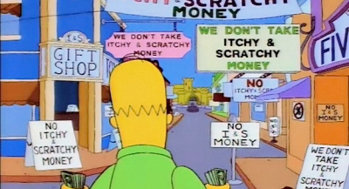
TOKENS!
how?
Notes:
TOKENS!
You need something to represent the user allowing a piece of software to do something on their behalf.
The token should encapsulate
a set of permissions
a finite lifespan
be entirely managed server side.

Slide 13
OAUTH 2.0
it’s what everyone uses
Notes:
OAuth 2.0
Used by Google, Twitter, Facebook…..
GUTTED OF SECURITY
WHY? Sacrificed at the later of performance when faced with huge traffic.
This lead to the lead of the project quitting.
There are some IETF proposals like the Bearer Token
I used a version of this at MS

Slide 14
BANHAMMER!
Notes:
BANHAMMER!
You get granular revocation all the way up to nuking a user from orbit.
Doesn’t need to compromise the whole account.
Makes more complex ownership, sharing and workflows possible
The matchmaking example - list of users or a list of matches identified uniquely.

Slide 15
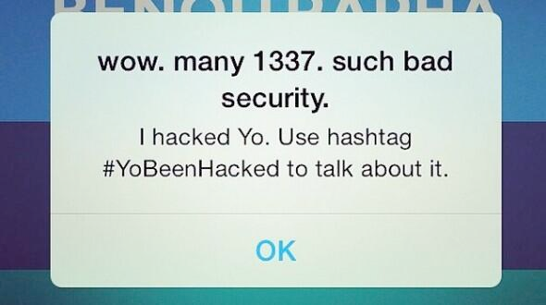
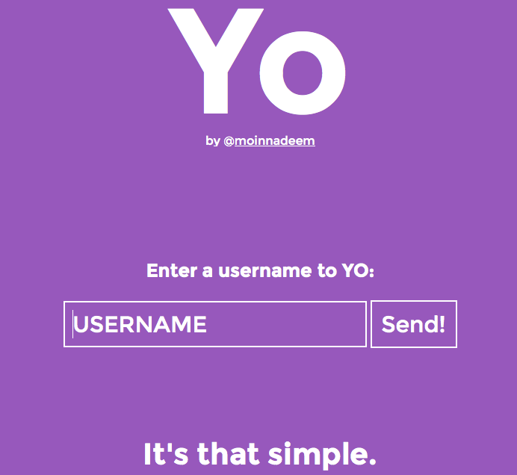
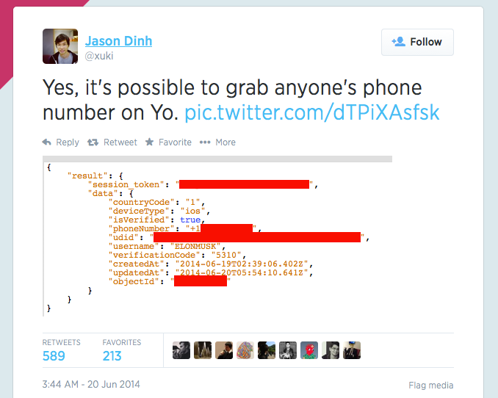
yo!
startup engineering
Notes:
Startup engineering
Injected code
Bad API
Bad access controls

Slide 16
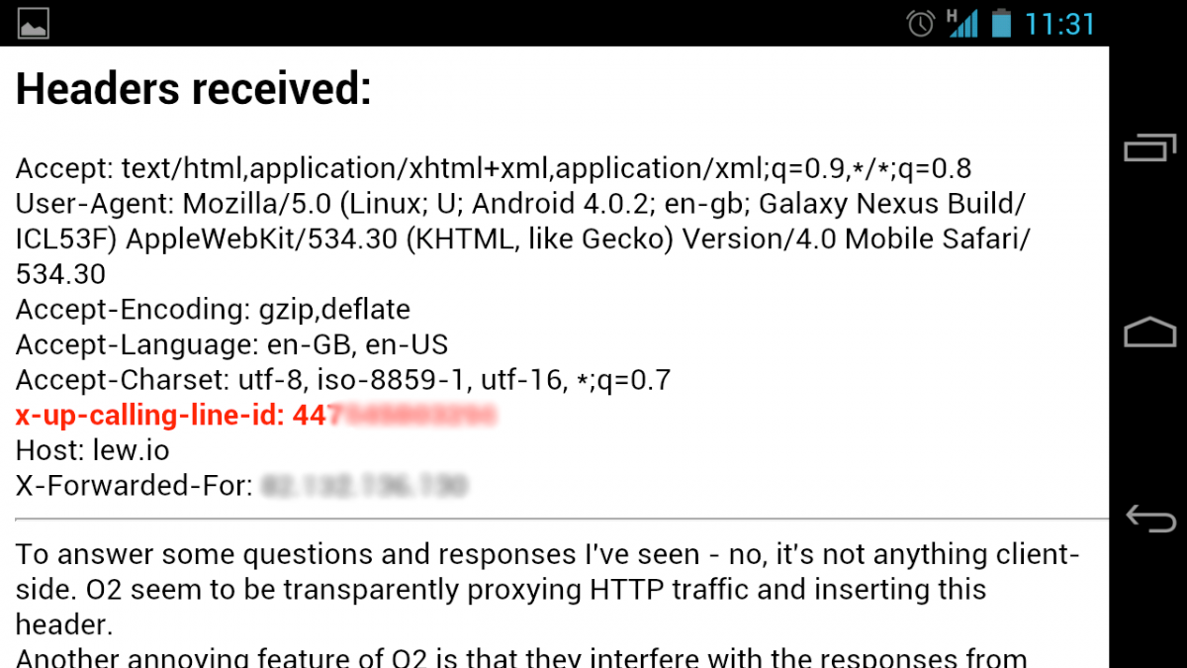
O2
INFORMATION Leakage
Notes:
Information leakage

Slide 17
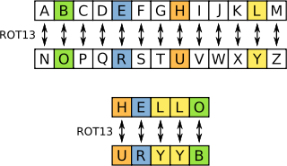
encryption
Transport
Data at rest
Cryptographic hash (one-way)
Reversible (two-way)
Symmetric
Asymmetric
Notes:
Transport - SSL, TLS, HTTPS
Data at rest - your storage - database, filesystem, nosql
Cryptographic hash - for storing passwords
Reversible - you eventually need the original data like files on your hard drive
Symmetric - Both know the same secret - less computationally intensive typically
Assymetric - Public key encryption - big primes

Slide 18
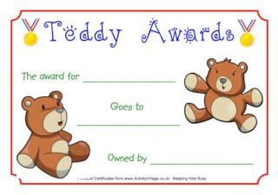
ssl certificates
Who has bought one?
Who has generated one?
Who has invalidated one?
Who can deploy one?
Notes:
Ordering one - certificate signing request
Know how to get one into production? Know about IP/vHost limitations and SNI?
Have you made your own certificate authority before?
Managed CRLs before?

Slide 19

MANaging secrets
Updating certificates
Rolling keys
Service passwords
Who knows all your secrets?
Are your secrets safe?
The “Secret Server”
Notes:
We know all your secrets
Where do you store
certificates
passwords
critical information
Source control? VERY BAD
Secret server/service? Allows you to decouple secrets from the service.
Encrypted file? Not bad.
Rolling keys - have a plan for keys being changed or rotated. Reasons: compromise, age, management….
USE PASSWORDS ON YOUR DATABASE

Slide 20

so good they gave it a logo
bugs bugs bugs
Notes:
Sometimes you just have honest-to-goodness coding bugs
Have a plan for deploying updates QUICKLY

Slide 21
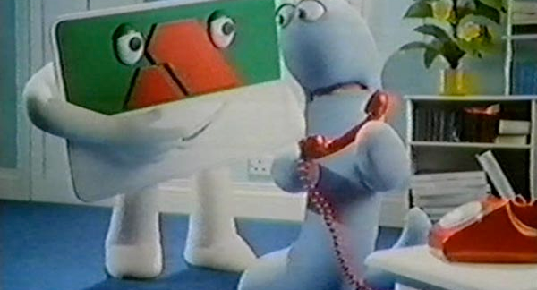
access control
storage security
Notes:
You will find services lacking - e.g., Azure tables and blob storage
Not just ACLs for end user, but employees, clients as well
Had to build an Access Control layer on top before. This was to make sure developers knew what resources they were interacting with and how.
Principle of least privilege - only give the absolute access necessary.
You will see data relationships that cause you to segment away more critical data from more frequently accessed data.

Slide 22
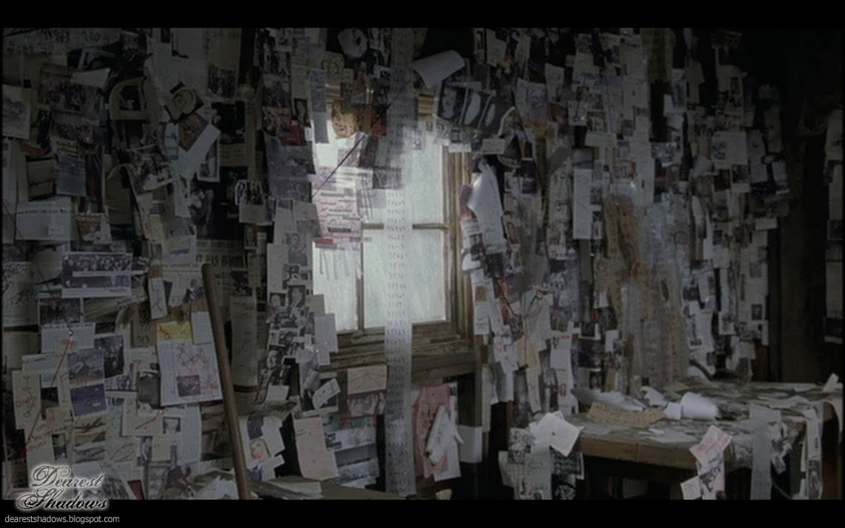
Notes:
We’ve only begun to scratch the surface
How do we go about solving this?
These will be obvious, but you need solid foundations for good security

Slide 23

code quality
Static analysis
Language specific tools
Don’t repeat yourself (D.R.Y)
Code coverage
Notes:
All warnings on, all warnings as errors
Static analysis - stops the dumbest of errors
Language specific tools - Python: e.g. PEP8, PyLint, PyFlakes
Don’t Repeat Yourself - fix a bug once
Code coverage - if the code is never executed except in production how do you know it is good?

Slide 24

testing
Load
Unit
API/Client
Browser
Integration
Run locally
Run SSL dev servers
Know your snake oil
Notes:
Get yerself some unit, load, browser, integration (end-to-end), API/Client
Tests should run easily on developer’s machines
Developers should understand and edit the test code and framework
Developers should run local SSL server
Should know how to regenerate snake oil

Slide 25

continuous deployment
Keeping third party dependencies up to date
Managing third-party code drops
Use short(ish) expiries to get used to updating
Be ready to switch services
Notes:
Continuous deployment
3rd party code drops and updates
Updating certificates and third party service dependencies
Be ready to switch providers, the decision may be out of your hands for money, buddies, or plain security disasters (I have an example there…)

Slide 26

architecture
Notes:
Architecture
Load balancer/reverse-proxy
DDOS protection
ELB
Hiding server layout
Limit entry points into the system
Secure subnets
Use the infrastructure if possible
CDN
Reduce load
Increase responsiveness
Make sure you trust them!
Cache
Be careful of stale data
Hackers could exploit it
Incentive if money is involved (like sales, price changes)

Slide 27
twitter
xss - cross site scripting attacks
Sanitise your output
Notes:
Twitter XSS
Sanitise your output!
Bleach
Escaping

Slide 28

(D)DOS
Notes:
DDOS
Load balancers
Logging
Closed-source (Azure, Amazon) - so behaviour is not known or understood
Rolling your own is tricky
IP? What about NAT?
Other metrics?
Constantly need tweaking

Slide 29
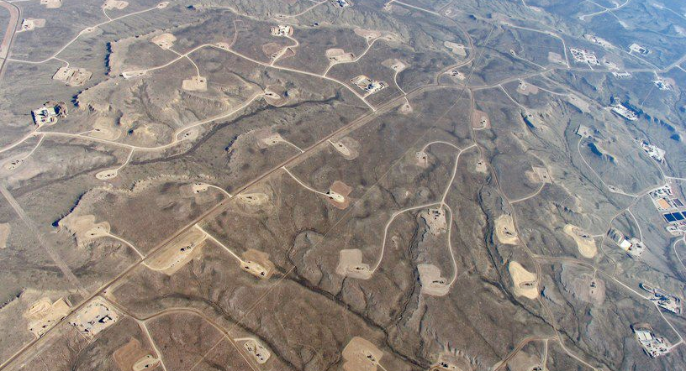
SQL injection
Notes:
SQL Injection
Always use the ORM!
Escaping!
Django has no known SQL injection attacks open

Slide 30
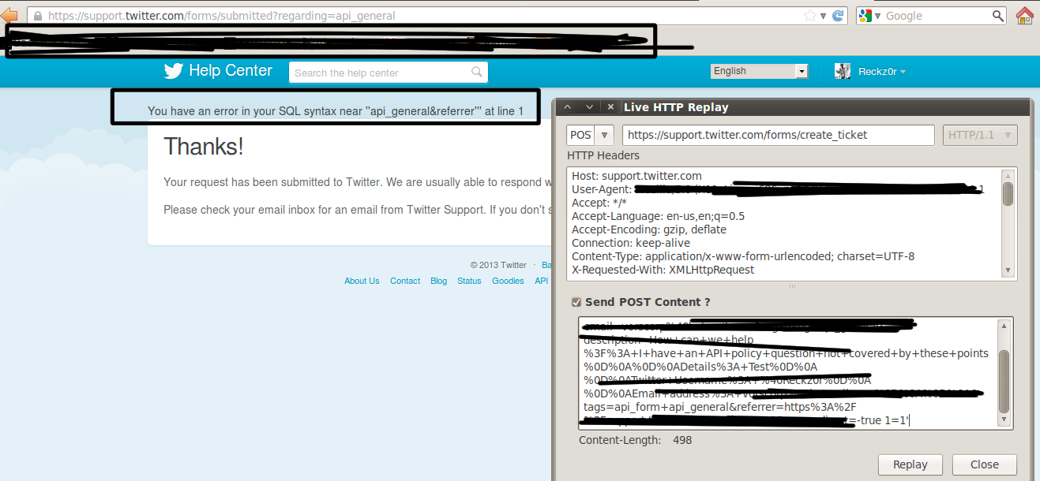

twitter
sql injection
Notes:
Twitter SQL injection
XKCD example

Slide 31
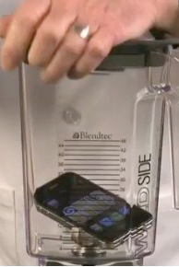
mixed content
HTTP and HTTPS on one page
IFRAMEs
Notes:
Mixed content
HTTP can extract HTTPS content on the page - they share the DOM
IFRAME - cry cry cry - weep weep
Use XFrame headers - you have to be sure the browsers implement it right

Slide 32

Logs
good vs bad
Intrusion detection
Error logs
Easy to accidentally expose
Contains sensitive information
Notes:
Logs are your friend and your enemy
Good
You can find intrusion information
Errors could be early warnings of vulnerabilities
Bad
Accidentally publicly readable
Contains sensitive information because they are used for debugging
Easy attack vector to get that kind of information
You can make PHP execute your log so if there is some way of a user getting something written there, you could be in trouble.

Slide 33
ebay
Internal network Data breach
Notes:
Internal network data breach

Slide 34

What have I missed?
Open relays
CSRF
Brute force
Hashing is not encryption!
SSL ciphers
PCI compliance
CVEs and vulnerability disclosures
Do not trust the user!
File format parsing
Pen tests
Physical pen tests
Cookies
Reproducible builds
SChannel
PHP
RSA4
goto fail;
Malicious governments
Physical intrusion
More passwords stolen
Incident response
Physical security solutions
Fuzz testing
Session hijacking
And sooooooooooo much more
Notes:
So much, so much, my head, this could take HOURS!

Slide 35

tools and resources
BURP
Fiddler2
Wireshark
Wifi Pineapple
Mozilla Security Blog
https://blog.mozilla.org/security/
Bromium Labs Blog
http://labs.bromium.com/
Bromium Blog
http://blogs.bromium.com/
OWASP https://www.owasp.org/
OWASP Top Ten Project
Notes:
Ch-ch-ch-check it out

